Slide 1
Data Link Control Protocols
Dr. Muazzam A. Khan

Slide 2
Functions of Data Link Layer Protocols
A data link protocol provides three functions:
Controls when computers transmit (media access control).
Detects and corrects transmission errors (error control).
Identifies the start and end of a message (message delineation).

Slide 3
Media Access Control
Media access control (MAC) refers to the need to control circuits when devices transmit.
Two types of MAC:
  Polling
  Contention

Slide 4
Transmission Error Control
All transmission media have potential for introduction of errors
All data link layer protocols must provide method for controlling errors
Error control process has two components
  Error detection
  Error correction

Slide 5
Error Control in Networks
There are two types of errors associated with networks.
  Human errors, controlled by application programs
  Network errors, controlled by the network
There are two categories of network errors.
  Corrupted data (that have been changed)
  Lost data

Slide 6
What are Network Errors?
Network errors are a fact of life in data communications networks.
Normally errors occur in bursts.
  In a burst error, more than one data bit is changed by the error-causing condition.
  Errors are not uniformly distributed, regardless of error rate statistics.

Slide 7
Network Error
The fact that errors tend to be clustered in bursts rather than evenly dispersed is both good and bad:
  Good: long period error-free transmission
  Bad: it is more difficult to recover the data from the errors.
    I h*ve a p*ncil in my p*cket
    I have a *e**il in my pocket
    Give me your *oney, or I’ll ki** you.

Slide 8
Error Detection
It is possible to develop data transmission methodologies that give very high error detection and correction performance.
The only way to do error detection and correction is to send extra data with each message.
In general, the larger the amount of error detection data sent, the greater the ability to detect an error.

Slide 9
Error Detection
There are three common error detection methods.
  Parity Checking
  Longitudinal redundancy checking
  Polynomial checking
    Checksum
    Cyclic Redundancy

Slide 10
ABCDEFG 1 2 3 4 5 6 7
Sender
BAD 214 + 2 = 436 = DCF
Error ECF
Destination
436 – 2= 214 = BAD
ECF 635 – 2= 413 = DAC Detected n Error is this message

Slide 11
Flow Control
When data is being sent faster than it can be processed by receiver
Ensuring the sending entity does not overwhelm the receiving entity
  Preventing buffer overflow
Transmission time
  Time taken to emit all bits into medium
Propagation time
  Time for a bit to traverse the link

Slide 12
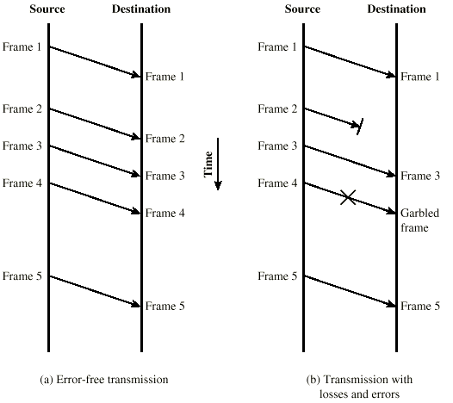
Model of Frame Transmission

Slide 13
Stop and Wait
Source transmits frame
Destination receives frame and replies with acknowledgement
Source waits for ACK before sending next frame
Destination can stop flow by not send ACK
Works well for few frames
Very inefficient, especially when a single message is broken into separate frames.

Slide 14
Fragmentation
Large block of data may be split into small frames
  Limited buffer size
  Errors detected sooner (when whole frame received)
  On error, retransmission of smaller frames is needed
  Prevents one station occupying medium for long periods
Stop and wait becomes inadequate

Slide 15
Sliding Windows Flow Control
Allow multiple frames to be in transit
Receiver has buffer W long
Transmitter can send up to W frames without ACK
Each frame is numbered
ACK includes number of next frame expected

Slide 16
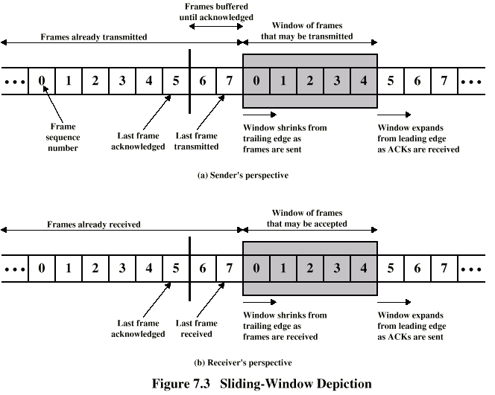
Sliding Window Diagram

Slide 17
Sliding Window Enhancements
Receiver can acknowledge frames without permitting further transmission (Receiver Not Ready)
Must send a normal acknowledge to resume
If duplex, use piggybacking
  If no data to send, use acknowledgement frame
  If data but no acknowledgement to send, send last acknowledgement number again.

Slide 18
Error Correction
A receiver that detects an error simply asks the sender to retransmit the message until it is received without error.
  Lost frame
  Damaged frame
With Stop and Wait the sender stops and waits for a response from the receiver after each message or data package.
Responses are:
  Error detection
  Positive acknowledgment (ACK)
  Negative acknowledgment and retransmission (NAK)
  Retransmission after time-out

Slide 19
Automatic Repeat Request (ARQ)
Stop and wait
Go back N
Selective reject (selective retransmission)

Slide 20
Stop and Wait (ARQ)
Source transmits single frame
Wait for ACK
If received frame damaged, discard it
  Transmitter has timeout
  If no ACK within timeout, retransmit
If ACK damaged,transmitter will not recognize it
  Transmitter will retransmit
  Receive gets two copies of frame
  Use ACK0 and ACK1

Slide 21
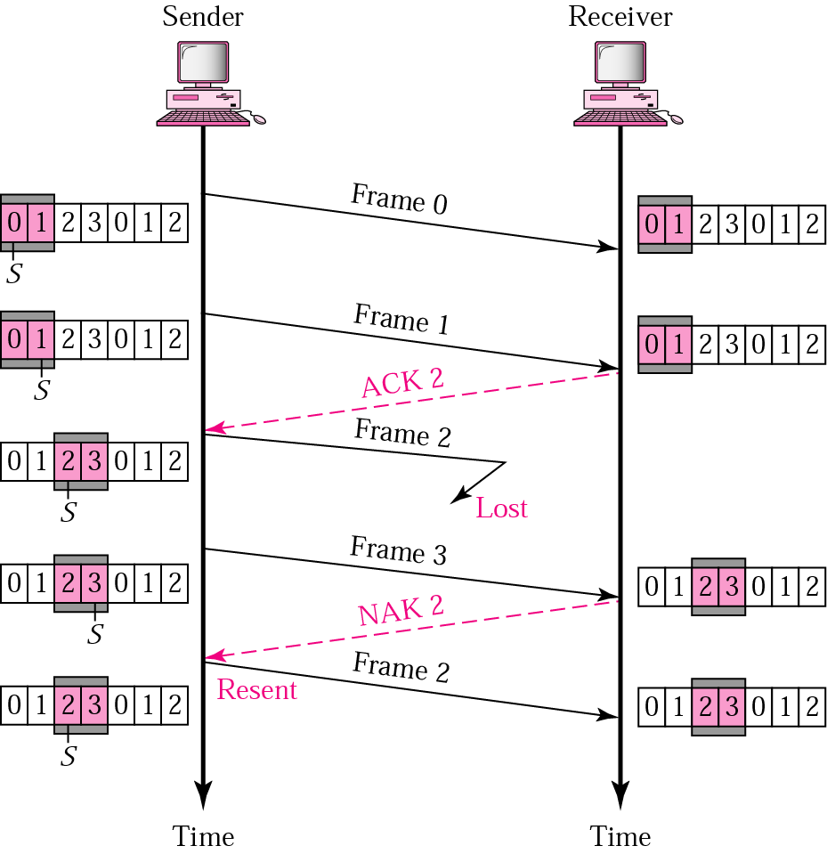
11.13 Selective Repeat ARQ, lost frame

Slide 22
Stop and Wait - Pros and Cons
Simple
Inefficient

Slide 23
Go Back N
Based on sliding window
If no error, ACK as usual with next frame expected
Use window size to control number of outstanding frames
If error, reply with rejection
  Discard that frame and all future frames until error frame received correctly
  Transmitter must go back and retransmit that frame and all subsequent frames

Slide 24
Go Back N - Damaged Frame
Receiver detects error in frame i
Receiver sends rejection-i
Transmitter gets rejection-i
Transmitter retransmits frame i and all subsequent

Slide 25
Go Back N - Lost Frame (1)
Frame i lost
Transmitter sends i+1
Receiver gets frame i+1 out of sequence
Receiver send reject i
Transmitter goes back to frame i and retransmits

Slide 26
Go Back N - Lost Frame (2)
Frame i lost and no additional frame sent
Receiver gets nothing and returns neither acknowledgement nor rejection
Transmitter times out and sends acknowledgement frame with P bit set to 1
Receiver interprets this as command which it acknowledges with the number of the next frame it expects (frame i )
Transmitter then retransmits frame i

Slide 27
Go Back N - Damaged Acknowledgement
Receiver gets frame i and send acknowledgement (i+1) which is lost
Acknowledgements are cumulative, so next acknowledgement (i+n) may arrive before transmitter times out on frame i
If transmitter times out, it sends acknowledgement with P bit set as before
This can be repeated a number of times before a reset procedure is initiated

Slide 28
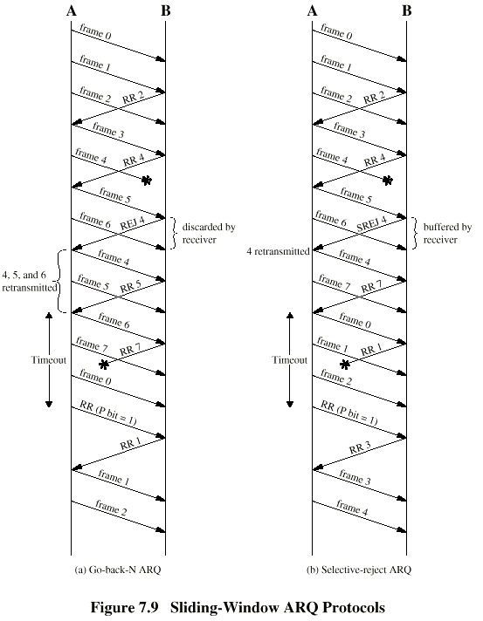
Go Back N -
Diagram

Slide 29
Selective Reject
Also called selective retransmission
Only rejected frames are retransmitted
Subsequent frames are accepted by the receiver and buffered
Minimizes retransmission
Receiver must maintain large enough buffer
More complex login in transmitter

Slide 30
Selective Reject -
Diagram

Slide 31
High-Level Data Link Control (HDLC)
HDLC was defined by ISO for use on both point-to-point and multipoint data links.
It supports full-duplex communication
Other similar protocols are
  Synchronous Data Link Control (SDLC) by IBM
  Advanced Data Communication Control Procedure (ADCCP) by ANSI
  Link Access Procedure, Balanced (LAP-B) by ITU.

Slide 32
HDLC Overview
Broadly HDLC features are as follows:
Reliable protocol (selective repeat or go-back-N)
Full-duplex communication
Bit-oriented protocol
Flow control
  adjust window size based on receiver capability
Uses physical layer clocking and synchronization to send and receive frames

Slide 33
HDLC Overview
Defines three types of stations
  Primary
  Secondary
  Combined
Defines three types of data transfer mode
  Normal Response mode
  Asynchronous Response mode
  Asynchronous Balanced mode
Three types of frames
  Unnumbered
  information
  Supervisory

Slide 34
HDLC Station Types
The three stations are :
  Primary station
    Has the responsibility of controlling the operation of data flow the link.
    Handles error recovery
    Frames issued by the primary station are called commands.
  Secondary station,
    Operates under the control of the primary station.
    Frames issued by a secondary station are called responses.
    The primary station maintains a separate logical link with each secondary station.
  Combined station,
    Acts as both as primary and secondary station.

Slide 35
HDLC Link Configurations
Unbalanced
  One primary and one or more secondary stations
  Supports full duplex and half duplex
Balanced
  Two combined stations
  Supports full duplex and half duplex

Slide 36
HDLC
Unbalanced Mode
Commands
Primary
Responses
Secondary
Secondary
Balanced mode
Combined
Combined
commands/Responses

Slide 37
HDLC
The three modes of data transfer operations are
  Normal Response Mode (NRM)
    In this case,
    Secondaries (terminals) can only transmit when specifically instructed by the primary station.
    Unbalanced configuration, good for multi-point links
  Asynchronous Response Mode (ARM)
    Same as NRM except that the secondaries can initiate transmissions without instruction from the primary station
    Reduces overhead as no frames need to be sent to allow secondary nodes to transmit
    Transmission proceeds when channel is detected idle , used mostly in point-to-point-links
  Asynchronous Balanced Mode (ABM)
    Mainly used in point-to-point links, for communication between combined stations

Slide 38
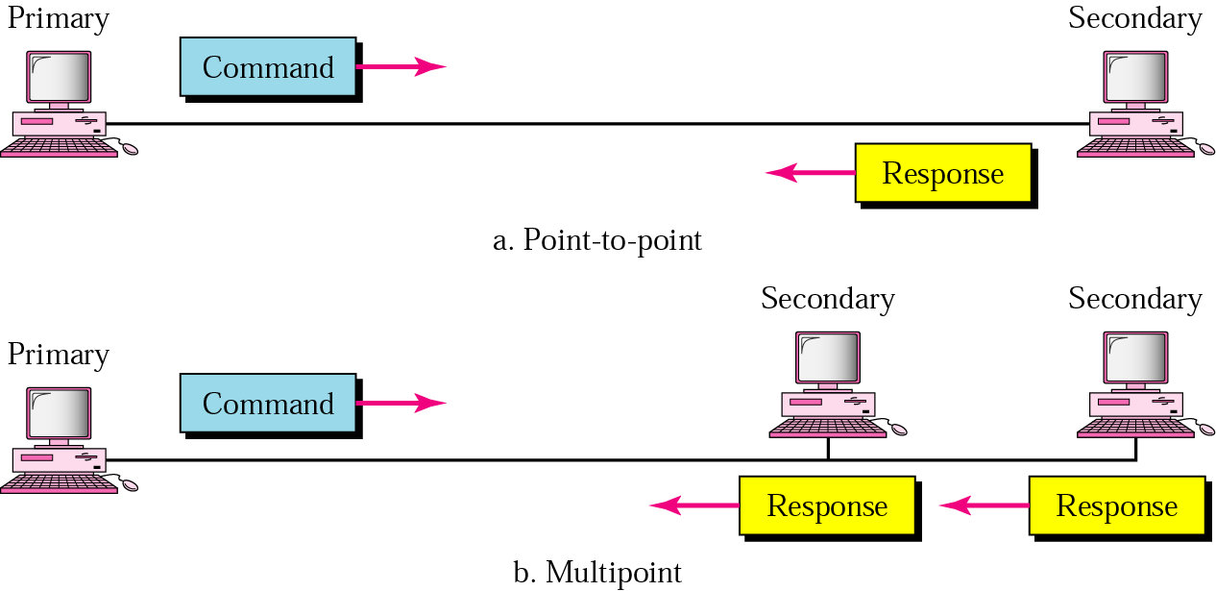
NRM

Slide 39
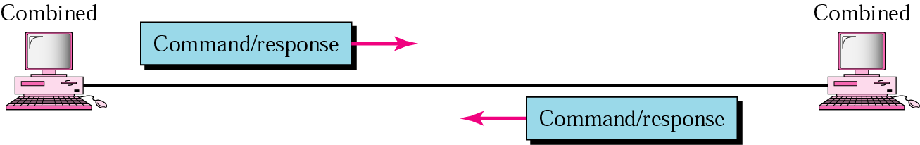
11.16 ABM

Slide 40
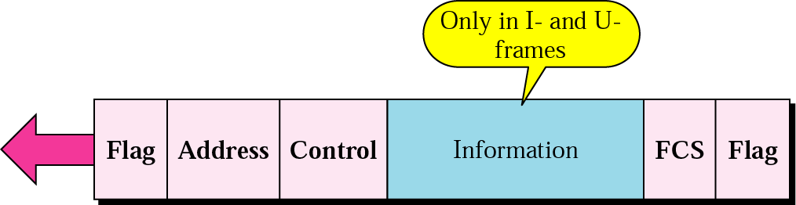
HDLC frame

Slide 41
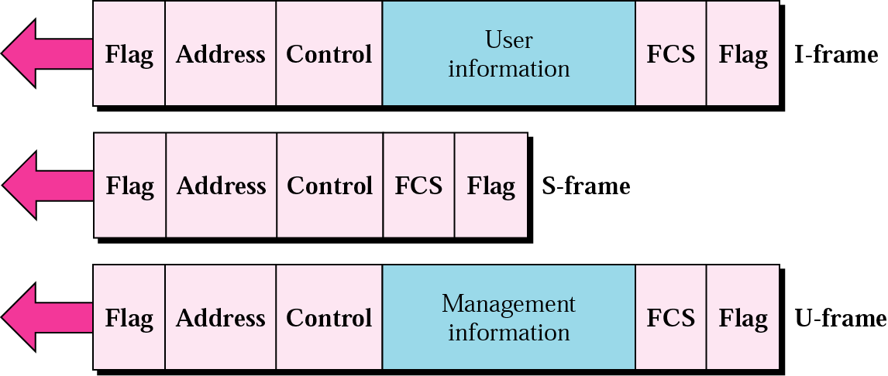
11.18 HDLC frame types

Slide 42
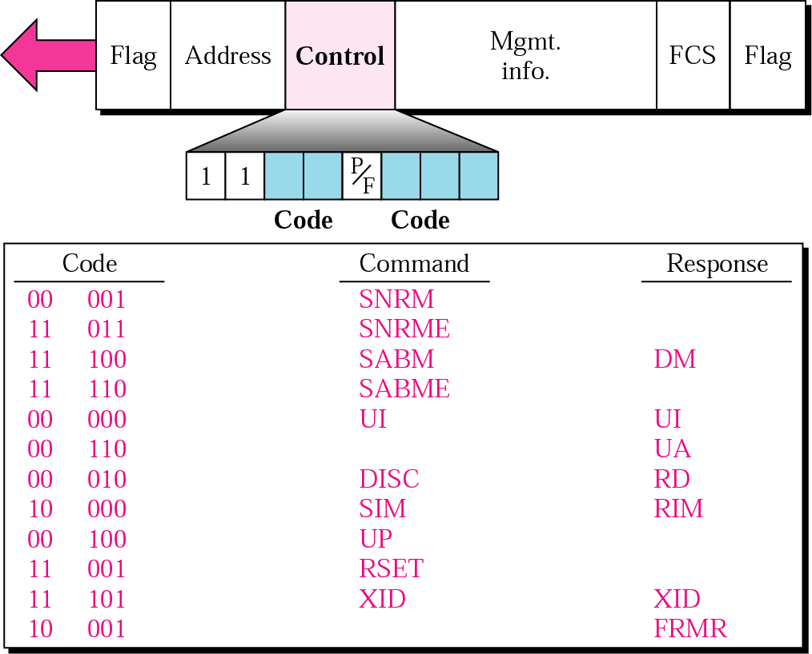
11.21 U-frame control field in HDLC

Slide 43
Table 11.1 U-frame control command and response
Command/response | Meaning
SNRM | Set normal response mode
SNRME | Set normal response mode (extended)
SABM | Set asynchronous balanced mode
SABME | Set asynchronous balanced mode (extended)
UP | Unnumbered poll
UI | Unnumbered information
UA | Unnumbered acknowledgment
RD | Request disconnect
DISC | Disconnect
DM | Disconnect mode
RIM | Request information mode
SIM | Set initialization mode
RSET | Reset
XID | Exchange ID
FRMR | Frame reject

Slide 44
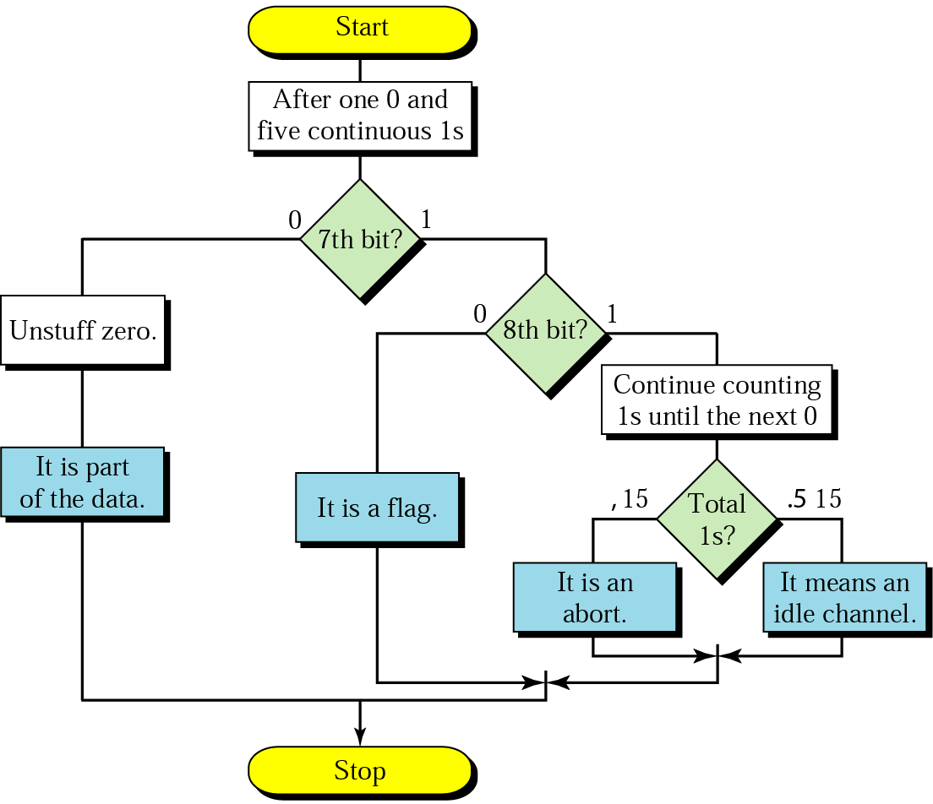
11.25 Bit stuffing in HDLC

Slide 45
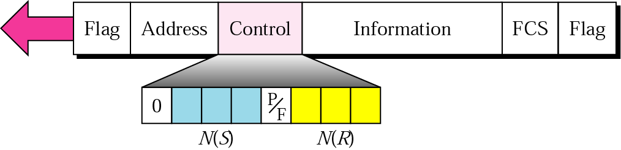
11.19 I-frame

Slide 46
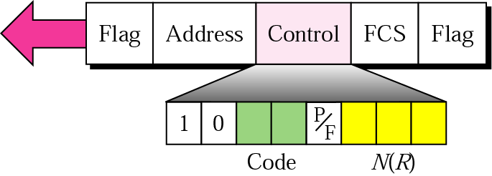
11.20 S-frame control field in HDLC

Slide 47
HDLC Operation
Exchange of information, supervisory and unnumbered frames
Three phases
  Initialization
  Data transfer
  Disconnect

